Slide 1




Elmhurst
Increasing Pneumococcal Vaccine Compliance Rate
Performance Improvement Project
PNA & FLU
Coordinating Team Meeting
Presented by:
Varun Putta
Intern at Quality Management,
Elmhurst Medical Center

Slide 2

Elmhurst
Current Pneumonia Vaccine Compliance Landscape
Key Points:
Overall Vaccine Compliance Rate: ~52.47% (2023-2024 Average)
Vaccine compliance trend: Fluctuating between 45% to 60% from May 2023 to November 2024
Primary challenge: Low compliance despite availability of the vaccine

Slide 3
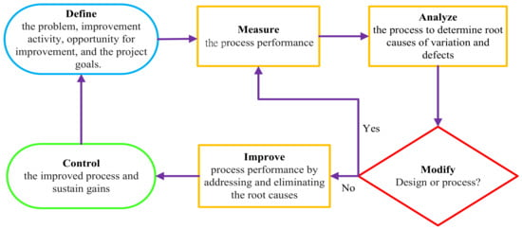
Elmhurst
Project Aim & Timeline
Aim: Increase pneumonia vaccine compliance by 10% by November 2024
Project Initiation: June 2024
Key Milestones:
July 2024: Interventions designed with stakeholder input
Ongoing Monitoring: Regular review meetings and tracking with doctors, nursing staff and allied healthcare workers.

Slide 4
Elmhurst
Process Measure: Total pneumonia vaccines administered (e.g., B6 unit data)
Tracking the total number of vaccines administered allows us to monitor the effectiveness of the intervention in increasing vaccine distribution and identify any gaps in the vaccine delivery process.

Slide 5
Elmhurst
Outcome Measure: Percentage of vaccine-compliant patients
This measure directly reflects the success of our interventions in improving vaccine compliance, providing a clear indicator of progress toward our 10% increase target.

Slide 6
Elmhurst
Balancing Measure: Percentage of patients with a length of stay between 2-7 days
Ensuring that vaccine compliance improvements are not skewed by patient length of stay helps maintain the integrity of the data and ensures that changes are truly representative of overall improvements.

Slide 7
Elmhurst
Equity Lens
Focus on Hispanic and Black populations
Data Insights:
Significant gaps in vaccine compliance between these groups and total population
Example: Hispanic compliance rate in May 2023 (24.5%) vs. Black compliance rate (16.7%)

Slide 8
Elmhurst
Key Interventions
Integration of Vaccine Orders into Admission/Discharge Protocols
Revise Discharge Workflow: Include vaccine status checklists
Enhanced Patient Education: Improve materials and create visual aids
Staff Reminders: Create visual aids for staff on the importance of vaccines

Slide 9
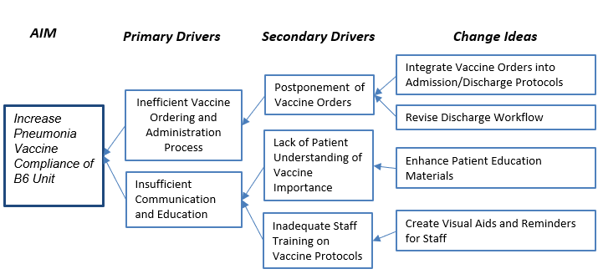
Elmhurst
Key Interventions : Root Cause Analysis
Primary Drivers:
Inefficient Vaccine Ordering and Administration Process
Insufficient Communication and Education
Secondary Drivers:
Postponement of Vaccine Orders
Lack of Patient Understanding
Inadequate Staff Training

Slide 10
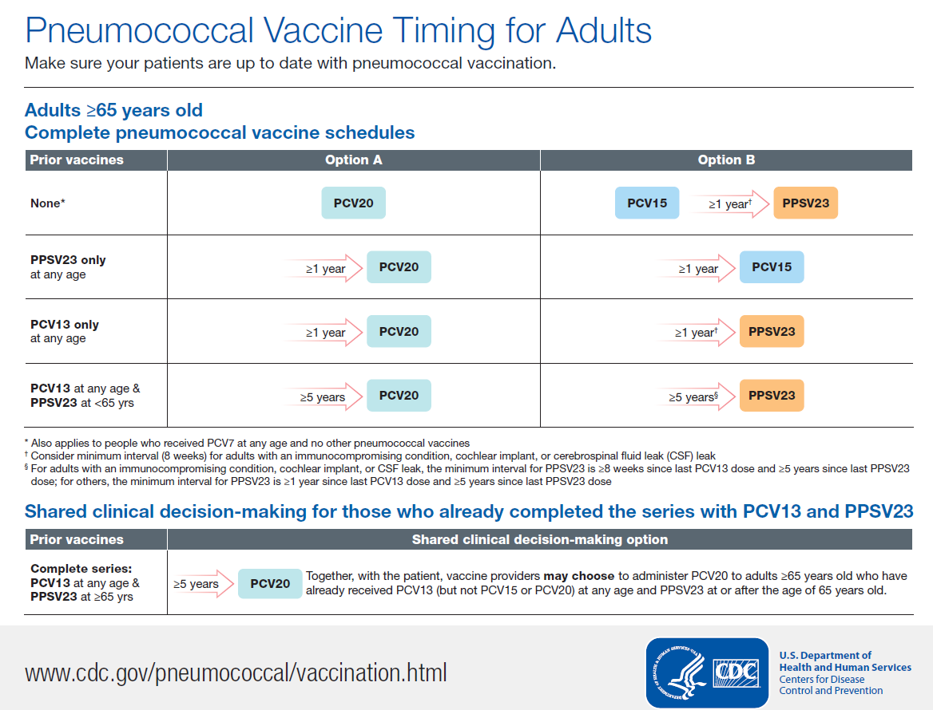
Elmhurst
Visual Aids

Slide 11
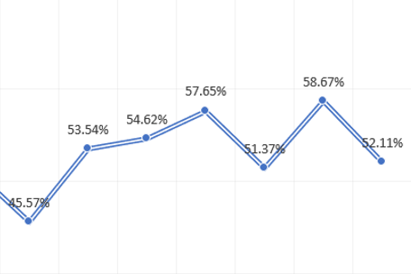

Elmhurst
Conclusion
Key Points:
Significant progress made towards improving pneumonia vaccine compliance
Long-term sustainability and continuous improvement are key to achieving the 10% target
Focus on equity, education, and streamlined processes for sustained success

Slide 12
Elmhurst
Long-Term Sustainability Plan
Key Actions:
Integrate Vaccine Orders into admission/discharge protocols
Patient Education: Develop long-term educational campaigns and resources (Easy to understand
Data Tracking: Ongoing monitoring of vaccine compliance and improving surveillance
Stakeholder Collaboration: Partner with local health organizations and in-house programs (Similar to Flu vaccine)

